Slide 1
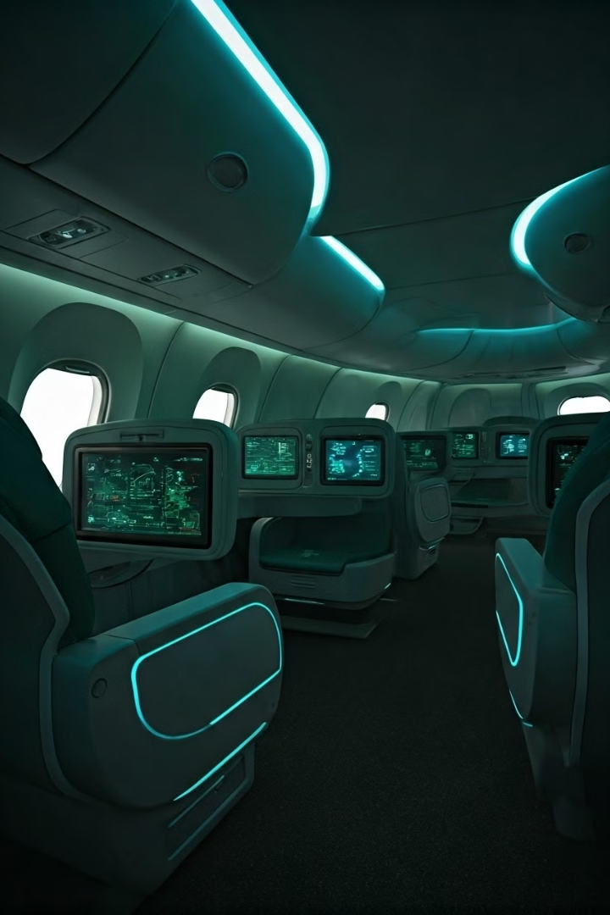
Digital Twin for Aircraft Cabin Storage Optimization
Enhancing luggage stowage efficiency and passenger experience through simulation.
by Rizwan Khan
KHA22555272
RK

Slide 2
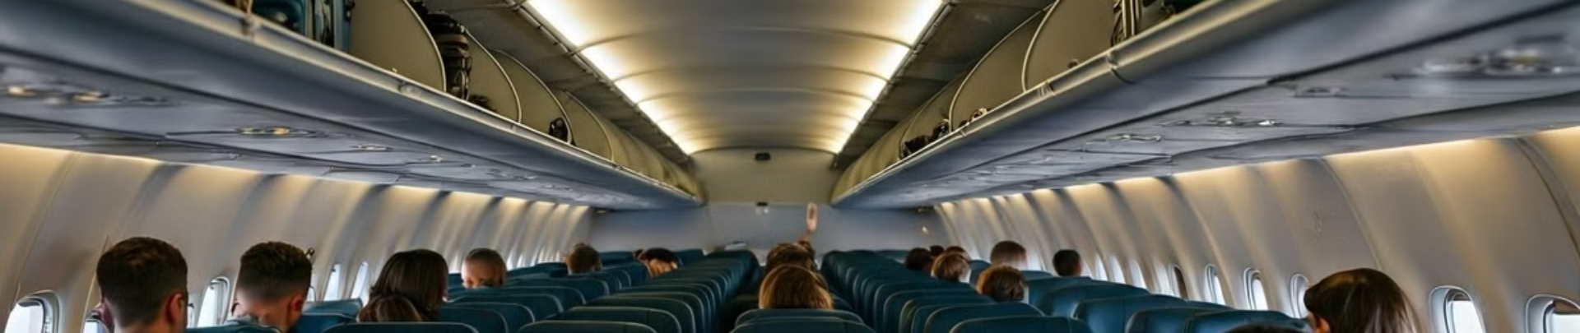
Problem and Importance
Did you know that inefficient luggage storage on flights can lead to an average of 10 to 30 minutes minimum of extra boarding time per flight?
1
Inefficient Storage
2
Passenger Frustration
3
Operational Challenges
Current cabin storage systems cause boarding delays.
Limited space leads to poor travel experience.
Airlines struggle with luggage management and boarding times.

Slide 3
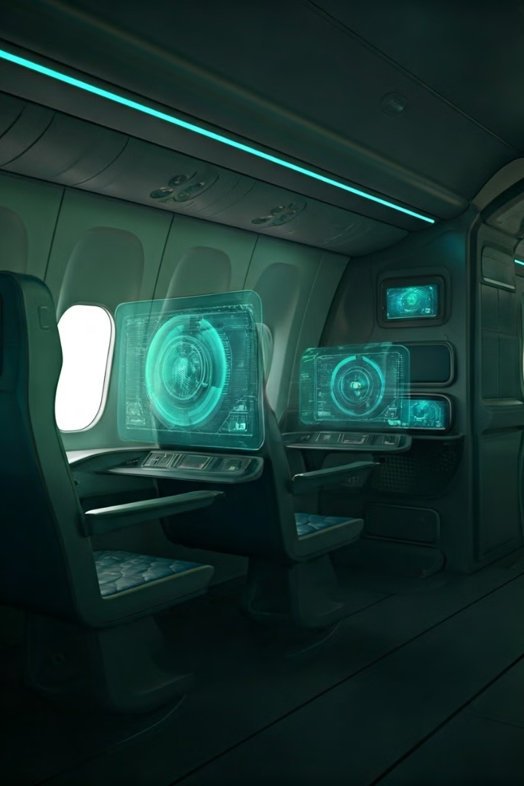
Project Aims and Objectives
Aiming to optimise aircraft cabin carry-on luggage storage for improved efficiency and reduced time wastage.
1
Primary Aim
Optimise carry-on luggage stowage using digital twin technology
to reduce passenger waiting times and improve overall satisfaction.
2
Objective 1
Develop a 3D digital twin model of cabin storage by early December 2024.
3
Objective 2
Collect and analyse data on luggage dimensions and passenger loading patterns.
4
Objective 3
Simulate storage configurations, reducing boarding time 15% by early March 2025.

Slide 4

Required Resources
Human
Technological
Financial
Knowledge in digital twin modelling, data analysis, and simulation engineering.
CAD software (SolidWorks, AutoCAD), simulation tools (AnyLogic, Simulink), and data analysis platforms (Python, R).
Budget for software licenses, hardware, and data collections.

Slide 5
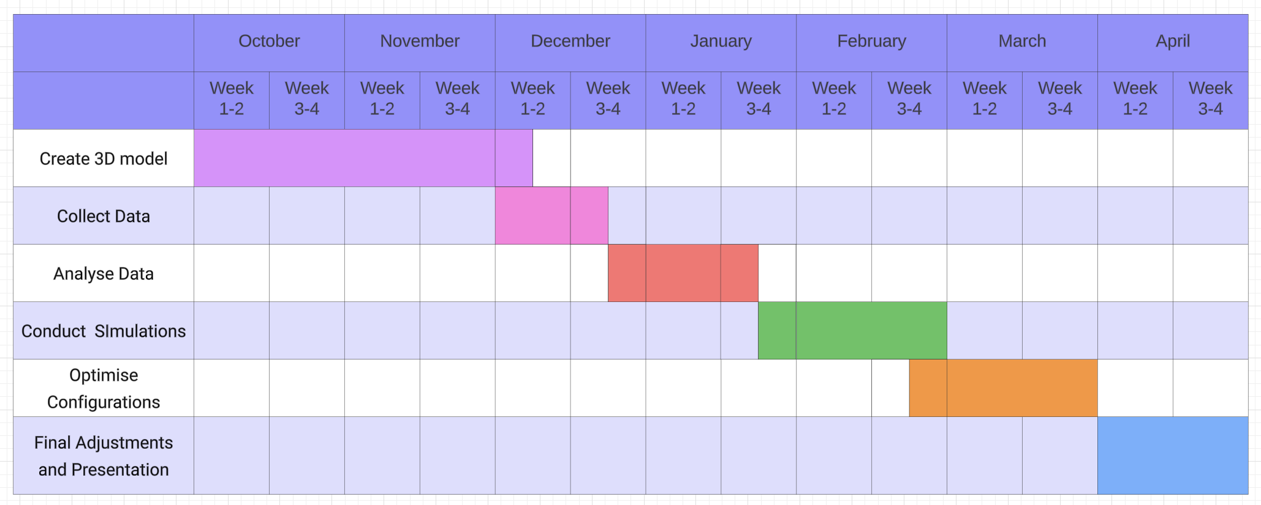
Project Timeline

